Slide 1
PCN QI Projects Guidance
Chris Roche/Joe Blackford

Slide 2
Data Availability
Existing Products
Integrated Locality Report
Respiratory Dashboard
Mental Health Data Packs
Cancer Data Packs
Dementia Dashboard

Slide 3
Gloucestershire Patient centred data set
Having a common pseudonym across all of the data in the data warehouse has allowed the development of the patient centred data set
Patient
Geographic & Demographics
Chronic Conditions
Primary Care Appointments
Secondary Care Activity
Community Service Use
Mental Health Service Use
Patient Level with Common Pseudonym
Age, Gender, Deprivation, Some wider determinants
QOF, non-QOF and eFI, derived from Read Coding
Appointments and Read Coded Events
ED, Outpatients, AEC, Admitted Patient Activity (EL and NEL)
District Nursing, Integrated Community Services, Rapid Response
Adult MH, CAMHS, LD, IAPT, Liaison and Inpatient services
Notes:
Other approaches can be taken, that are not at patient level. We can analyse service usage for example.

Slide 4
The NHS Data Model and Dictionary
Gives a reference point for assured information standards, to support health care activities in the NHS in England. The NHS Data Model and Dictionary has been developed for everyone who is actively involved in the collection of data and the management of information in the NHS.
Provides the development, maintenance and support of NHS Information Standards
https://www.datadictionary.nhs.uk/index.html

Slide 5
National Data Sets
Data Sets bring together a collection of Data Elements into a specification for collection or analysis for a specific transaction, use case for data exchange or a specific outcome.
Types of data set include:
Administrative Data Sets
Commissioning Data Sets (CDS)
Central Return Data Sets
Clinical Content
Clinical Data Sets
Supporting Data Sets
National Data sets offer conformity, standardisation, DQ checks/reporting, robust IG and the ability to compare
However, the requirement to be consistent can make them inflexible and don’t always meet local need

Slide 6
Local Data Sets
Data Sets defined locally between commissioners and providers according to requirement. The content and management are described in the provider content, specifically schedule 6
Why use local?
Where no National data set exists
Where Data items are needed that are not captured National specifications
More flexibility around governance, linkage and usage required
More frequent flow than might be supplied nationally
However, more difficult to draw comparisons outside of local system

Slide 7
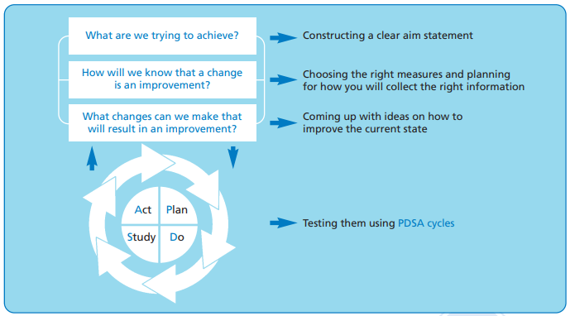
Measurement for Improvement Approach
Small tests are easy
Small is easy to undo
People are happier to try small changes
There is less risk
Seek usefulness not perfection
Measure the minimum
Remember the goal is improvement and not a new measurement system
Aim to make measurement part of the daily routine

Slide 8
Steps to Measuring for Improvement
1 Decide Aim
2 Choose Measures
3 Define Measures
Step 1 - Decide Our Aim(s)
The aim statement should be unambiguous clear, specific, numerical, measurable – it MUST state “How much’ and ‘By when’
Step 2 - Choose Our Measures
Step 3 - Confirm How to Collect/Record Our Data
Step 4 - Collect Our Baseline Data
Step 5 - Analyse and Present the Data
Step 6 - Review - Meet to Decide what it is Telling Us
Step 7 - Repeat steps 4-6 as required
4 Collect Data
5 Analyse & Present
6 Review Measures
7 Repeat steps 4-6

Slide 9
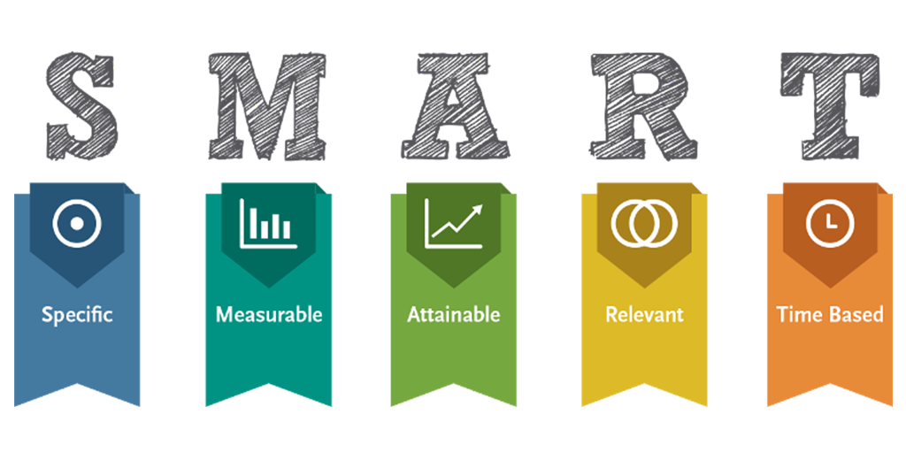
What are we trying to accomplish? CHECK – is your aim SMART?
Specific – have you been specific about what you want to improve?
Measureable – have you included a numerical target?
Achievable – is it achievable?
Relevant – does it relate to patient outcomes? can you link it to the strategic aims of your organisation?
Time-Bound – have you included a timeframe for the project?

Slide 10
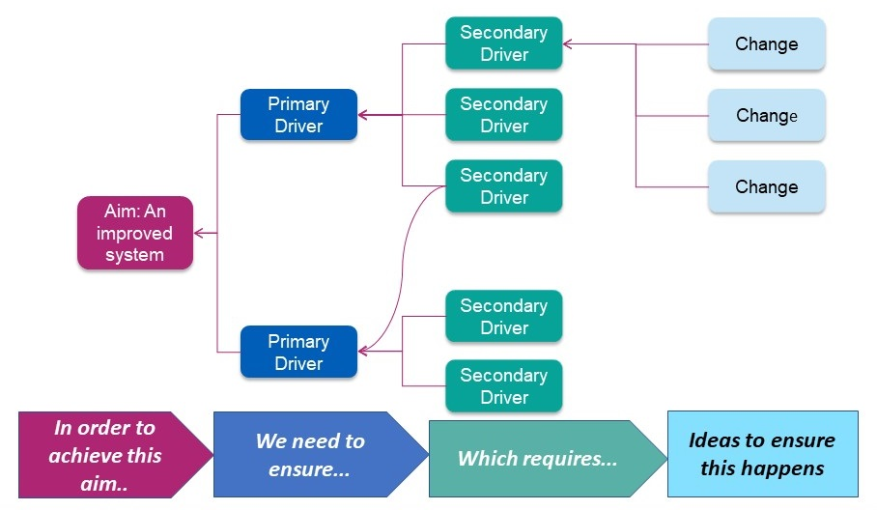
Driver diagrams
A tool for thinking about both your changes and your measures.
On the left we usually have our main (outcome) aim. On the right we depict ideas for system changes that might ultimately impact the outcome.
The diagram represents our theory about how to modify the system to change the outcome.

Slide 11
Choose Our Measures
What do we need to measure to evidence we have achieved our aim?
Outcome Measures - linked explicitly to the aim of the project
e.g. Aim - To ensure all patients identified as living alone don’t have any unmet personal care needs
Outcome measure - All patients contacted that identify unmet personal care needs have a referral to appropriate service
Data collection – Number of referrals and referred to service for patients contacted that identify unmet care needs
What about reduced/more “appropriate” service use? – How could we measure that?
Process measures - linked to the things we are going to work on to achieve the aim
e.g. Change idea - Use of a new Patient Script Template to ensure welfare of Isolated Patients
Process measure - % of patients contacted that required additional input to improve welfare
Data collection – The number that resulted in Action(s) Identified divided by the Number of patients contacted
Balancing measures - to spot unintended consequences
e.g. Measure - Patients contacted do not have increased levels of dissatisfaction
Data collection - A post call survey to those contacted to assess their satisfaction with the process
e.g. Measure - Number of unplanned contacts with health and care services should not increase
Data collection – For those contacted, look at activity levels pre/post intervention and test against a control group

Slide 12
Driver Diagram example
Intervention/action
P1
Conduct team brief
Driver
Avoid Mistakes
P2
Conduct team debrief
O2
Produce accurate lists
Aim
Driver
P3
Error free Surgery
Avoid Complications
Implement SSI bundle
O1
O3
Implement VTE bundle
Driver
Have correct kit to hand
Avoid Delays
O1 Overall glitch count
O2 Never events
O3 Number of surgical site infections
Ensure staff adequately trained
P1 % lists with Team Brief
P2 % lists with Team Debrief
P3 % compliance with SSI bundle

Slide 13
Key considerations
Have we set a Baseline?
What are we comparing to?
What are we expecting to see? Hypothesis
What service areas are we expecting to change? What codes?
Do we need to capture new data? If so how?
Do we need control groups?
How long until an impact is seen?
Do we need Qualitative & Quantitative data?
Have we included different types of measures? Process, Outcome, Balance
Are there other variables that may account for changes?
Have you considered IG and data management?
Notes:
Add to form. Add measure descriptors into the “What are we comparing to question”.

Slide 14
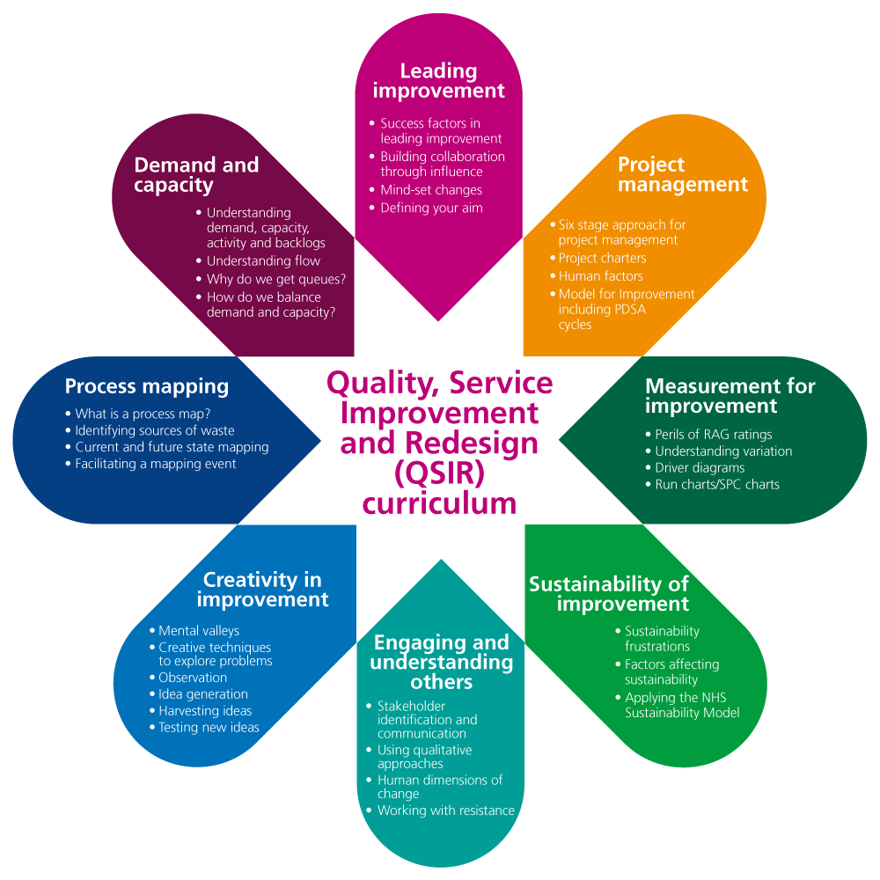
Quality Improvement contacts
To find out more about Quality Improvement tools, techniques and profession development please contact:
Jane Lee, Improvement Community Facilitation Manager: jane.lee15@nhs.net

Slide 15
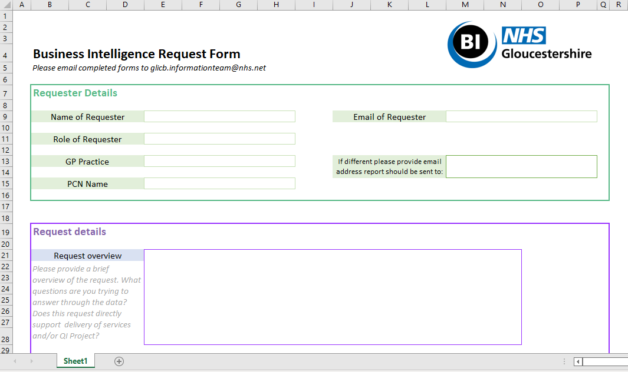
Request Form
To submit a request data from the BI team to support your PCN (e.g. QI Projects), please complete the request form available here.
Please email completed request forms to glicb.informationteam@nhs.net
Notes:
Timescales , Structure of BI team, Priioritisation - stages of a BI request.

