Slide 1
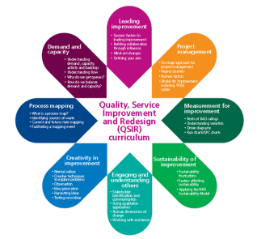
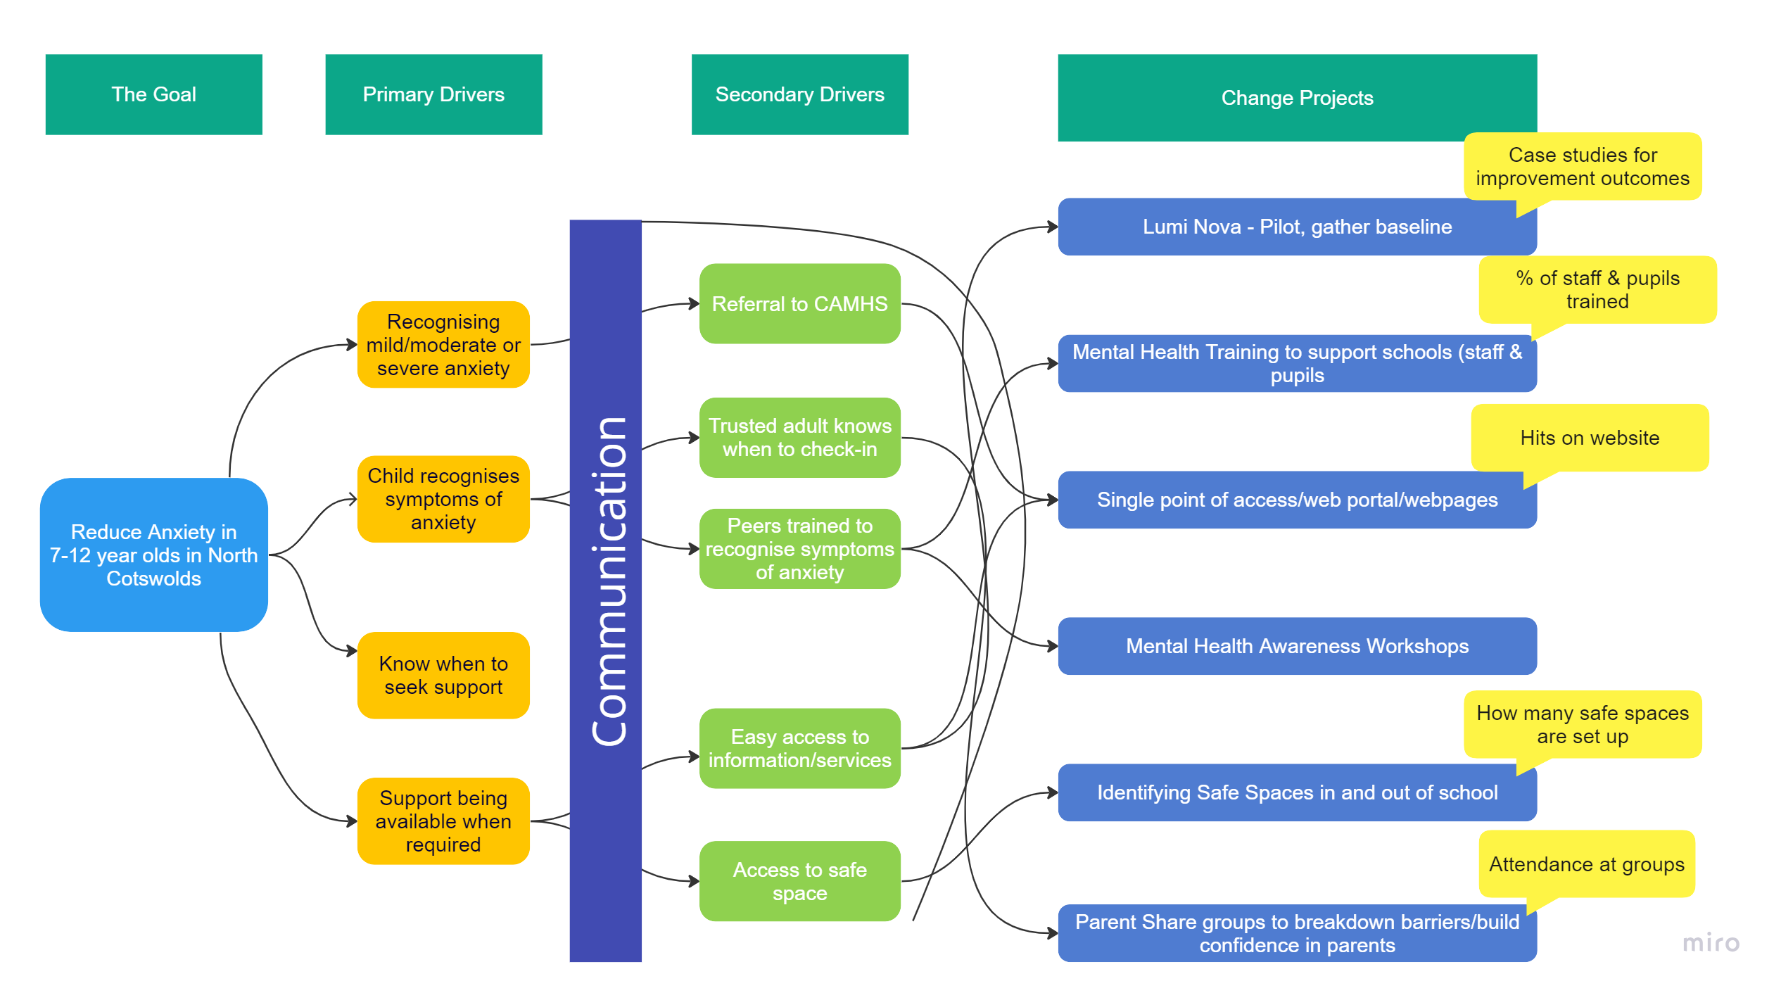
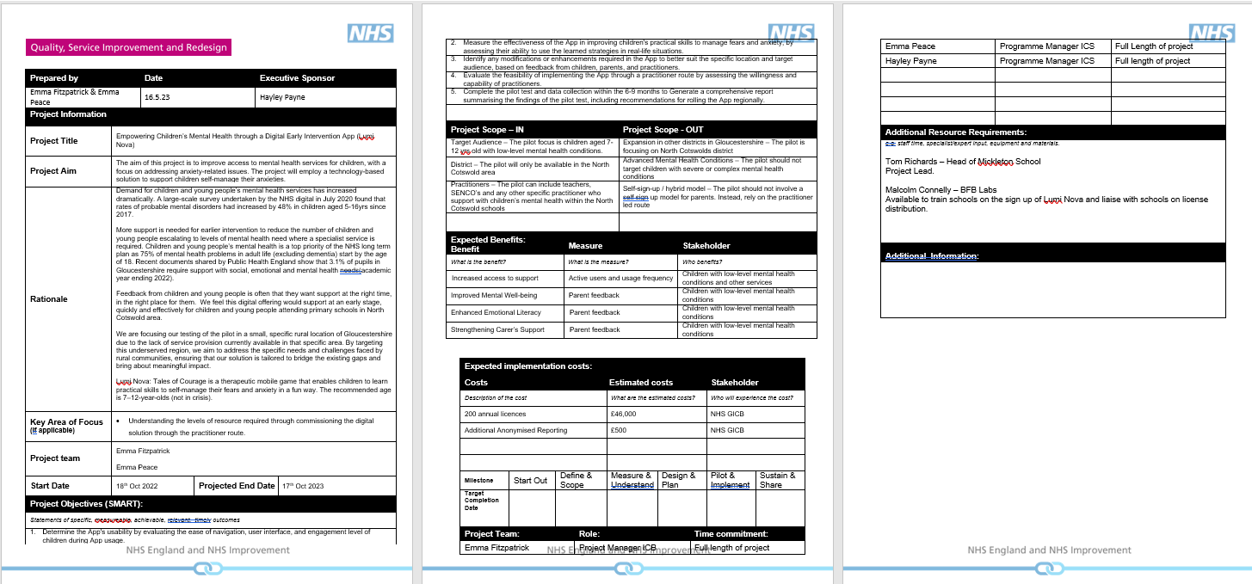
Empowering Children’s Mental Health through a Digital Early Intervention App (Lumi Nova)
This poster will be printed at A1 size for Content will be very expanded, so do use zoom to complete sections as needed
Describe the key tools and approaches used, including illustrations of your applications e.g.
Pathway map
Driver Diagram
Application of PDSA Cycles
Pareto Analysis
Stakeholder Maps
Run/SPC charts
Project Team
Emma Fitzpatrick & Emma Peace
Team: Give your names & organisations.
A photo of yourselves would be great.
Quality Service Improvement and Redesign (QSIR) Tools: Methodologies used and contribution to your project
About the Project
Demand for children and young people’s mental health services has increased dramatically. A large-scale survey undertaken by the NHS digital in July 2020 found that rates of probable mental disorders had increased by 48% in children aged 5-16 yrs since 2017.
More support is needed for earlier intervention to reduce the number of children and young people escalating to levels of mental health need where a specialist service is required. Children and young people’s mental health is a top priority of the NHS long term plan as 75% of mental health problems in adult life (excluding dementia) start by the age of 18. Recent documents shared by Public Health England show that 3.1% of pupils in Gloucestershire require support with Social, Emotional and Mental Health (SEMH) needs (academic year ending 2022).
About: give some background and context to your project. What was the problem, health need or transformation opportunity you were addressing?
Aims & Objectives
Aim:
The aim of this project is to improve access to mental health services for children, with a focus on addressing anxiety-related issues. The project will employ a technology-based solution to support children self-manage their anxieties.
Objectives:
Determine the app's usability by evaluating the ease of navigation, user interface, and engagement level of children during app’s usage
Measure the effectiveness of the app in improving children's practical skills to manage fears and anxiety, by assessing their ability to use the learned strategies in real-life situations.
Identify any modifications or enhancements required in the app to better suit the specific location and target audience, based on feedback from children, parents, and practitioners.
Evaluate the feasibility of implementing the app through a practitioner route by assessing the willingness and capability of practitioners.
Complete the pilot test and data collection within 6-9 months to generate a comprehensive report summarising the findings of the pilot test, including recommendations for future service commissioning.
Outcomes: can include a photo of your improvement in action e.g. education event, new information/forms.
Keep these SMART
Project Outcomes, Progress and Impact
Project Outcomes:
Improved Access to Support - The app has enhanced accessibility to support children with their fears and anxieties, this was evident in the user metrics, whereby the majority of user’s activated their accounts within 0-4 days.
Improvement in Mental Health for Users – There were noticeable improvements in users mental health and wellbeing; as shown in the conducted survey, reflecting the app’s effectiveness.
Increased Self-Management – The app empowered children and young people to manage their own wellbeing more effectively, encompassing a sense of independence and self-resilience.
Progress and Impact:
The app achieved a 71% uptake rate from the invites sent out by practitioners, signifying demand for support. Parents and guardians reported their satisfaction with the ease of using the app and observed initial improvements in their children’s mental health and wellbeing. Furthermore, practitioners have reported a reduction in Social, Emotional, Mental Health (SEMH) incidents among children using the app.
Learning for the Improvement Community
Engaging with key stakeholders before the project planning stage is crucial for aligning aims and objectives.
Collaborative efforts in forming the project team are essential to ensure ongoing engagement.
Establishing baseline data is vital for measuring the project’s impact and outcomes effectively.
Understanding the priorities of stakeholders before assembling the project team to address specific needs e.g. school calendars
Gain insights into the level of demand within the geographical area to tailor the project’s scope and resources.
Measures Used
User Engagement Metrics – We utilised several key metrics to assess user engagement: Conversion rate of Invite’s sent to activated accounts and the breakdown across schools, highlighting the reach of the project; average session time, which gave an understanding of users interest and engagement levels; and demographic analysis by gender and age, providing insights into the profile of our user base.
Outcome Score’s– The app has an in built outcome scale that allows users to rate their feelings before and after an activity. This features as a personal diary which tracks the users progress.
Feedback on Usability and Satisfaction – We conducted a survey among practitioners, parents and guardians, which included questions specifically aimed at assessing whether there was an improvement in the user’s mental health. This process provided a preliminary understanding of the app’s benefits and was crucial in gaining early insights into users satisfaction and usability.
Learning: Describe how your work applying QSIR approaches is supporting ICS development and the Improvement Community
Describe you metrics and measurement for improvement approach
#one_glos

