Slide 1
Pharmacy First
Guidance for Care Navigators and Receptionists
March 2024
Notes:
Standard title slide

Slide 2

The Pharmacy Elements of Primary Care Access and Recovery Plan (PCARP)
On 9th May 2023, NHS England and Department of Health and Social care published the Delivery Plan for recovering access to primary care.
The community pharmacy elements of the plan are:
  A Pharmacy First service which incorporates GP referral to Community Pharmacist Consultation Service (CPCS) and includes 7 new clinical pathways.
  Increase the provision of the NHS Pharmacy Contraception Service and the NHS Blood Pressure Checks Service.
  Improve the digital infrastructure between general practice and community pharmacy.
  A letter to practices on 25 January confirmed the Pharmacy First launch on 31 January: NHS England » Launch of NHS Pharmacy First advanced service

Slide 3
NHS Pharmacy First
Pharmacy First is a development of the former Community Pharmacist Consultation Service (CPCS) with the addition of 7 new clinical pathways.
This means the full service will consist of three elements:
Pharmacy First - Clinical pathways
Pharmacy First - Referrals for minor illness
Pharmacy First - Urgent repeat medicines supply
new service element
(uncomplicated UTI, Shingles, Impetigo, Infected insect bites, Acute Sore Throat, Acute Sinusitis, Acute Otitis Media)
Formerly CPCS
Formerly CPCS
Referral via 111, GP or UEC settings
NB Referrals from NHS 111 and UEC settings not from GP practices.
Community pharmacy contractors must provide all 3 elements of the service
Distance Selling Pharmacies (sometimes called internet or online pharmacies) cannot do the otitis media pathway (because they can only do remote consultations so cannot use otoscopes)
General practices cannot refer patients to pharmacies for urgent medicines supply using Pharmacy First but should refer appropriate patients for the other two elements (clinical pathways and minor illness)

Slide 4
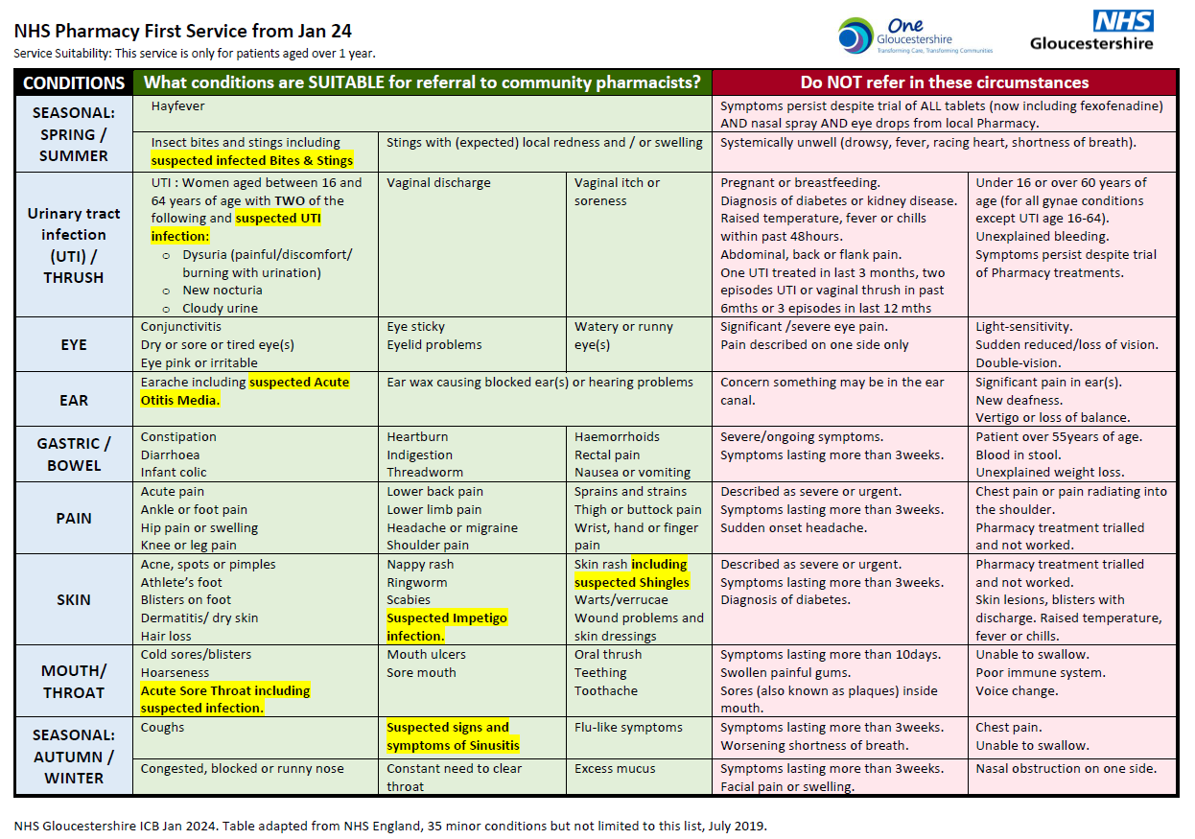

Slide 5
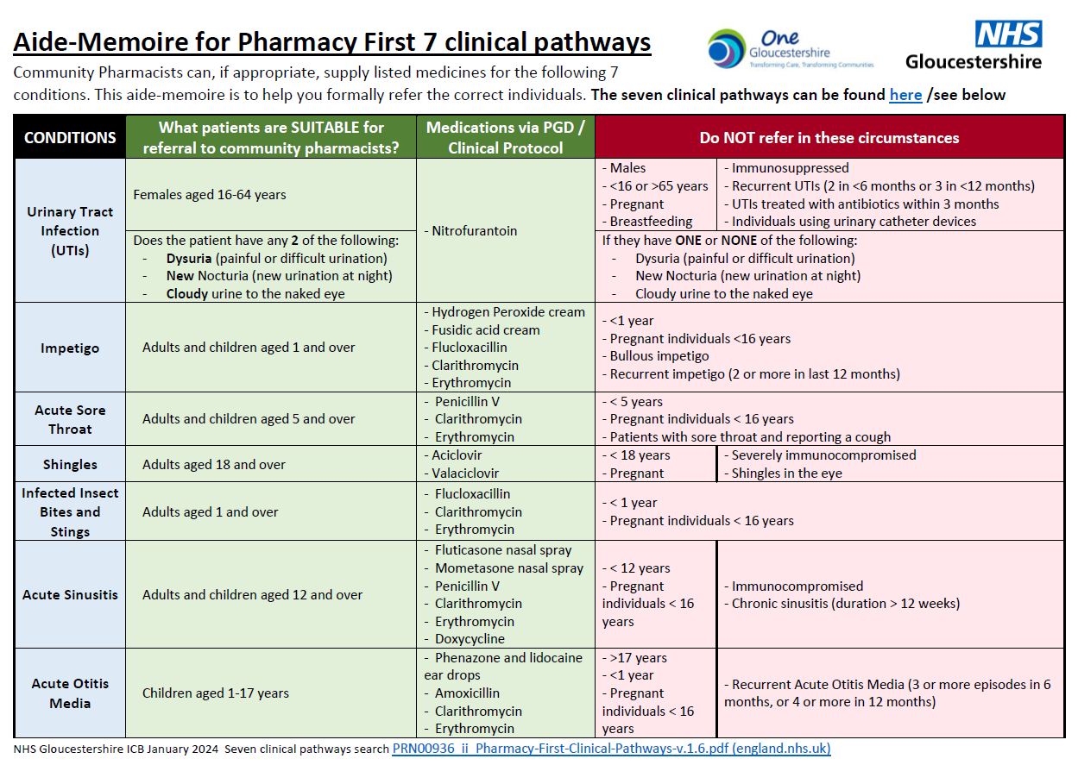

Slide 6
The 7 new clinical pathways that can be referred to Pharmacy First
The 7 clinical pathways have developed to enhance the former CPCS.
The pathways enable community pharmacists to treat patients for the most common conditions without the need for a prescription.
The community pharmacist will clinically assess the patient and then:
  Treat if clinically appropriate via Patient Group Direction (PGD)
  A PGD allows a pharmacist to supply specific prescription only medicines.
  Provide advice and support via sale of over-the-counter medicines if appropriate
  Refer patient onto another health professional or GP practice if clinically required
Clinical Pathway | Age range
Uncomplicated UTI Shingles Impetigo Infected Insect Bites Sinusitis Sore Throat Acute Otitis Media | Women 16-64 years 18 years and over 1 year and over 1 year and over 12 years and over 5 years and over 1 to 17 years

Slide 7
What are the benefits of utilising Pharmacy First for our patients?
To increase capacity in the practice so appropriate patients can be managed via a community pharmacy. GP appointments can be used for patients who really need them
To improve access for patients with minor illnesses
To create improved relationships between practices and community pharmacies to deliver high quality and integrated care to patients
To support the integration of community pharmacy into the wider Primary Care team
To help and empower patients to self-manage their health more effectively with the support of community pharmacists and improve health literacy
To change patient behaviour so they go to community pharmacy as the ‘first port of call’ for minor illness and medicines advice in the future.

Slide 8



Can’t I just tell patients to ‘go to a pharmacy?
Community pharmacies can only manage “walk-in” patients if they meet the clinical criteria for one of the new 7 pathway. Patients with other minor illness symptoms would be managed via self-care.
GP practices should continue to digitally refer patients to Pharmacy First as we did with GP CPCS as opposed to signposting.
Patients will receive a confidential consultation. If signposted, may be treated as self-care support and possibly managed by another pharmacy team member.
Patients are reassured that their concern has been taken seriously.
Referrals enable the pharmacy to plan and manage workload and the pharmacist will be expecting them. Thereby meaning patients are seen in a timely manner.
If the patient does not contact the pharmacy, the pharmacist will follow up based upon clinical need. If patient does not attend the referring GP would be made aware.
Referral data can evidence that patients are actively being supported to access appropriate treatment, evidencing that GP practices are supporting the PCARP.
Clinical responsibility for that episode of patient care passes to the pharmacy until it is completed or referred on.
There is an audit trail of referral and clinical treatment, which will support onward patient care.
Pharmacy First is a development of CPCS, patients should be referred as before. The 7 new clinical pathways support community pharmacists to treat patients more effectively.

Slide 9
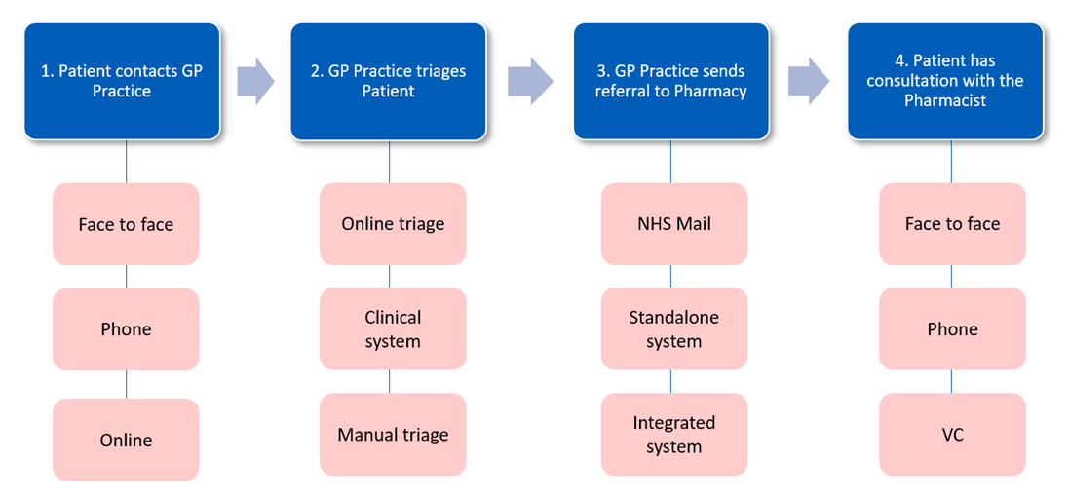
How do I refer patients to Pharmacy First?
Patients can be referred to Pharmacy First whether they have contacted the practice by phone, online or in person. The community pharmacist will provide a clinical consultation either remotely or in person depending upon symptoms or clinical need.
Everyone in the practice who makes appointments for patients must know how to refer patients to Pharmacy First
Continue to use the digital referral system and process that your GP practice used for the GP CPCS referrals.

Slide 10
How do I refer patients to Pharmacy First?
Where a patient is suitable:
Ask them which pharmacy they would like the referral to be sent to
Send a referral to the pharmacy AccuRx/AccuMail . The referral contains information about why the patient is being referred, for the pharmacist to review ahead of or during the patient’s consultation.
When the referral is made, the patient initiates contact with the pharmacy. Please say something to the patient such as: ‘Please contact the pharmacy to discuss your treatment and advise that you have been referred by your practice. The telephone number and address are as follows….’
Other phrases you may find useful when explaining the service to your patients:
‘Having listened to your symptoms, I am arranging a same day consultation for you with an NHS community pharmacist working with our practice.’
‘Community Pharmacists are highly trained professionals and can now do more assessments and issue prescription only medications for particular conditions ’
‘You can telephone or visit the pharmacy to have a discussion with the pharmacist in their confidential consultation room. The pharmacist will ask questions about your health and your symptoms, including any allergies or any medications you’re currently taking. In some cases, based on your symptoms, they may need to do a quick examination such as if you have earache, they may look in your ear with an otoscope.’

Slide 11


What happens next / what is the patient journey?
Patient contacts the Pharmacy
Patient consultation
Minor Illness Referrals
7 clinical pathways
Patient will have a private consultation with the community pharmacist in the pharmacy consultation room face to face or via a secure remote platform.
If the patient does not make contact with the community pharmacy, the pharmacist will assess and follow up with the patient as clinically appropriate.
The pharmacist will ask the patient questions about their health.
This may include their previous medical history, any allergies, any medicines they are taking and the symptoms they are currently experiencing.
For some conditions, the pharmacist may request to perform a quick examination, such as using an otoscope for patients presenting with acute otitis media symptoms.
For minor illness referrals, the patient outcomes can be:
advice,
advice and recommend self-care products
or onward referral by the community pharmacist to another health professional for further clinical review.
This could be or to another setting such as an urgent treatment centre or (in a small percentage of cases) back to the GP practice.
If the referral is for one of the 7 clinical pathways, the patient outcomes could include the supply of certain prescription only medicines when appropriate e.g. antibiotics if needed.
Other outcomes could include advice; advice and recommend self-care products; or onward referral by the community pharmacist to another health professional if required.

Slide 12
What about patient ‘bounce backs’ to the practice?
Previous CPCS activity showed that 9 out of 10 patients have their episode of care completed by the community pharmacist,
  - Pharmacists onward refer 1 out of 10 patients either back to the practice or to another setting such as an urgent treatment centre.
  - This is for many reasons (such as red flags may have been identified or the patient’s symptoms may have worsened).
  - This does not mean the service has failed – rather that it is working as expected.
The addition of the 7 clinical pathways, which enables community pharmacists to be able to supply specific prescription only medicines where clinically appropriate, may change the percentage of onward referrals to GP practices both in the short and long term as we better understand which patients and what conditions are appropriate for successful referral/
Improving local relationships and agreeing local ways of working between practices and community pharmacists will help to minimise ‘bounce backs’ which is better for practices, pharmacies and ultimately patients.

Slide 13
Working with Community Pharmacies to deliver Pharmacy First..
Community pharmacy contractors have welcomed Pharmacy First and 100% have registered to provide the service here in Gloucestershire
Clinical services from community pharmacies have grown over the last 5 years and Pharmacy First is the next step.
Community Pharmacists are highly trained healthcare professionals and are very experienced in supporting and treating patients with minor illnesses.
Many community pharmacists are already experienced in using PGDs for minor illness and training has been made available to support all pharmacists (including locums).
Workforce and workload remain a challenge for some community pharmacies (as for general practice)….. working together provides opportunity to improve resilience in primary care.
If you are wondering about your local pharmacies, then why not contact them and ask them? Pharmacy First will work best for patients when local practices and pharmacies work together.
If you have particular concerns about a pharmacy that you can’t resolve by contacting them, then our GICB Community Pharmacy Clinical Lead may be able help - contact sian.williams20@nhs.net

Slide 14
The Digital Elements
On 31 Jan 2024 when Pharmacy First launched:
Pharmacies now have access to new consultation templates for Pharmacy First from whichever of the 4 approved suppliers they contract with (PharmOutcomes, Sonar, Cegedim or Positive Solutions)
GP Practice teams should continue to electronically refer the way they do now. For most Gloucestershire practices this will be via AccuRx/AccuMail to the Pharmacy NHS mail see ICB ExtraNET and AccuRx digital referral SOP for ‘How to..’
Information will be returned to practices from pharmacies in the same way as it is now – for most pharmacies this is the Post Event Message (PEM). Shortly NHSE will enable GP record update to send structured messages in to GP clinical systems (S1 and EMIS) that will appear in patient record once accepted by a practice team member-
see NHSE Primary care bulletin 21 March 2024 (issue 282)
“Enhancing GP record updates from pharmacies (Update Record)
New functionality to provide practices with structured information about pharmacy consultations for blood pressure checks, contraception and Pharmacy First (minor illness and clinical pathways) will begin a phased roll out next week.
Practice staff will no longer have to manually manage this information; data will go straight into the workflow and can be automatically filed or viewed and filed with a single click by a member of practice team.
Practices will see a gradual increase in messages as pharmacy systems go live.
The service will reduce burden and improve patient safety by minimising the number of times information is inputted and showing relevant information more quickly in the Summary Care Record.”
See next slide for further information on this new digital element and PharmOutcomes which is the local pharmacy system that the majority of our pharmacy teams use, goes live before end April 2024. GICB will be in touch as soon as we know further detail on this.

Slide 15
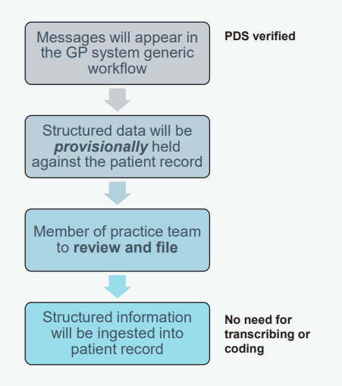
Additional Digital Elements – exact date TBC
As part of the improved digital connectivity between practices and pharmacies, community pharmacists will be able to view parts of the patient records via GP Connect. They will also use GP Connect to send a structured message of the consultation record and any medicines supplied back to the practice using GP Connect.
It is important that the structured message is ingested into the patient record at the practice so if the patient visits another setting for the same episode of care (the practice or another pharmacy) then previous actions and medicine supplies can be seen.
All structured messages will appear in the GP system generic workflow ‘for action’. Messages must be acknowledged/ actioned by GP staff after which information will be ingested into record without the need for transcription or coding.

Slide 16
Next steps
Please talk to your local community pharmacists about the Pharmacy First service and how you can work together to get the best patient outcomes.
Local community pharmacists, Community Pharmacy PCN Leads, the Community Pharmacy Clinical Leads in the ICBs and/or the LPCs are working together to support delivery of Pharmacy First. They may be contacting you to offer local support and to put you in touch with local community pharmacists who you may already be working with.
You might find it helpful to print off slides 4 and 5 which show the conditions and symptoms that can be electronically referred to community pharmacies.
Additional information related to other the PCARP pharmacy services (Pharmacy First, Blood Pressure Checks and Oral Contraception) are detailed on slides 19 and 20.
Further information is available at ICB ExtraNet Pharmacy First page
Please contact your Gloucestershire ICB Community Pharmacy Clinical Lead for any further information or support required – sian.williams20@nhs.net

Slide 17
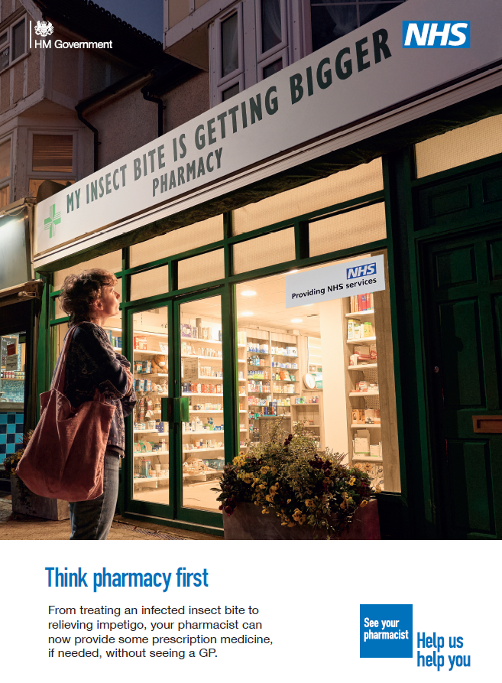
Pharmacy First Communications
On 19 February, a national communications campaign launched to increase the public's awareness of the breadth of support community pharmacists can offer to patients on their doorstep
The campaign will seek to demonstrate how the health service is making it more convenient for people to access care.
It will primarily target working age adults (18-40) who may experience minor health conditions. It will also reach ethnic minority groups and those with disabilities, to ensure it is addressing key health inequalities.
The new campaign will run across England, with adverts on TV on Demand, in public spaces such as bus shelters, as well as adverts on relevant websites and search engines, online videos and social media, supported by PR and partnership activity until the end of March 2024.
This will be supported with activity targeted to multicultural audiences and engagement with organisations to reach disabled audiences, including people with a learning

Slide 18
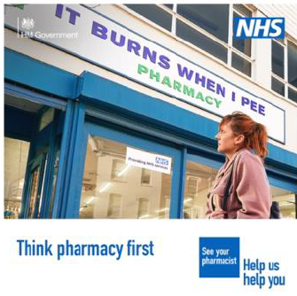
Pharmacy First Campaign support
All NHS Help Us Help You pharmacy campaign resources can be downloaded, free of charge, from the Campaign Resource Centre from 19 February.
Materials provided include a campaign toolkit with campaign messages, long and short copy and links to suggested social media posts to help you support the national campaign and PR activity.
You can support the campaign by:
Downloading the campaign resources and sharing these with your colleagues, including local community pharmacies offering the new service, local communications networks and community organisations.
Sharing campaign messages on social media, websites, email, and staff intranets to reach as wide an audience as possible
If you have any queries about the campaign, please contact the NHS England – South West communications team or our ICB communications team.

Slide 19
NHS Community Pharmacy Oral Contraception Service
This service enables community pharmacies to initiate and continue supplies of oral contraception.
Until 29 February 2024 some pharmacies may only be providing continuation of oral contraception. From 1 March 2024, all participating pharmacies will be initiating and continuing supply.
There is an NHS website postcode search tool to enable patients to find local pharmacies who deliver the contraception service.
Practices can refer people into this service or women can self-present at the pharmacy

Slide 20
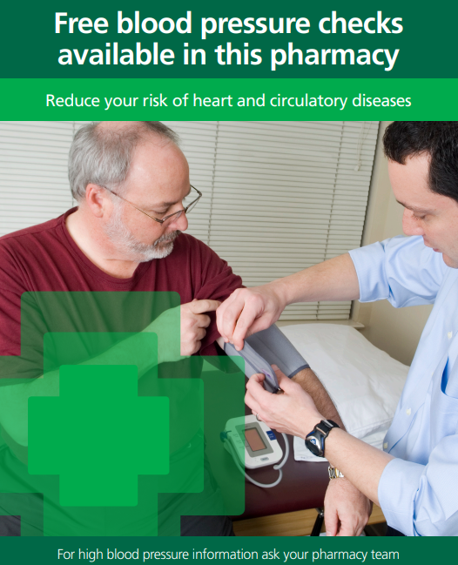
NHS Community Pharmacy Blood Pressure Check Service
Community pharmacy teams can offer people over the age of 40, without a diagnosis of hypertension, a BP check to find those with undiagnosed hypertension. In addition, they can also carry out BP checks at the request of practices.
Practices can ask pharmacies to complete clinic and ambulatory checks
It may be useful for practices who have patients on their hypertension registers without an up-to-date BP reading
It may be useful for practices with patients with a high initial reading who need ambulatory follow up
All readings will be returned to the practice for updating patient records
There is an NHS website postcode search tool to enable patients to find local pharmacies who deliver the Blood Pressure Check Service.
General practices can refer patients to community pharmacies for both clinic cuff and ambulatory measurements

Slide 21
Useful Resources
Gloucestershire ICB Pharmacy First ExtraNET - https://extranet.nhsglos.nhs.uk/primary-care/pharmacy-first/
Pharmacy First Service Specification, PGDs and Protocols - NHS England » Community Pharmacy advanced service specification: NHS Pharmacy First Service
Pharmacy First Service Letter to GP Practices, Community Pharmacies, ICSs - NHS England » Pharmacy First: supporting access to NHS care
Pharmacy First Launch Service Letter - NHS England » Launch of NHS Pharmacy First advanced service
Pharmacy First Department of Health and Social Care Summary - Pharmacy First: what you need to know - Department of Health and Social Care Media Centre (blog.gov.uk)

