Slide 1


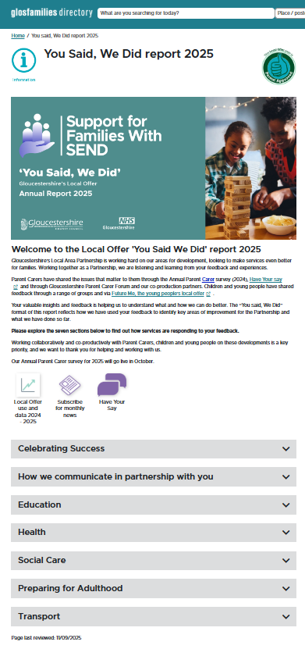

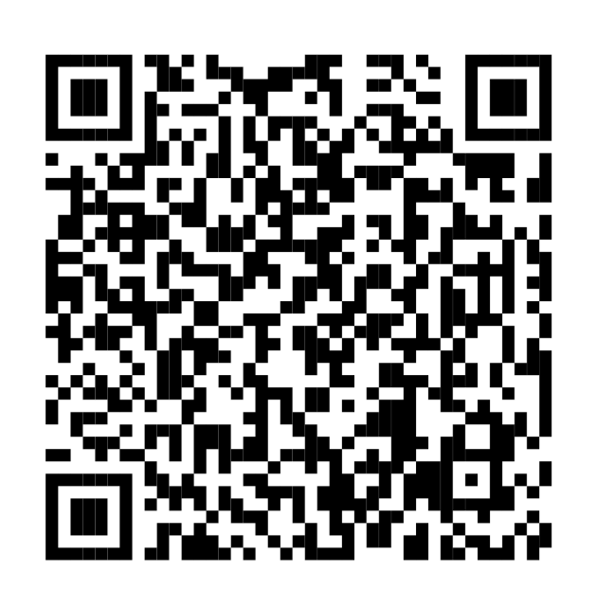
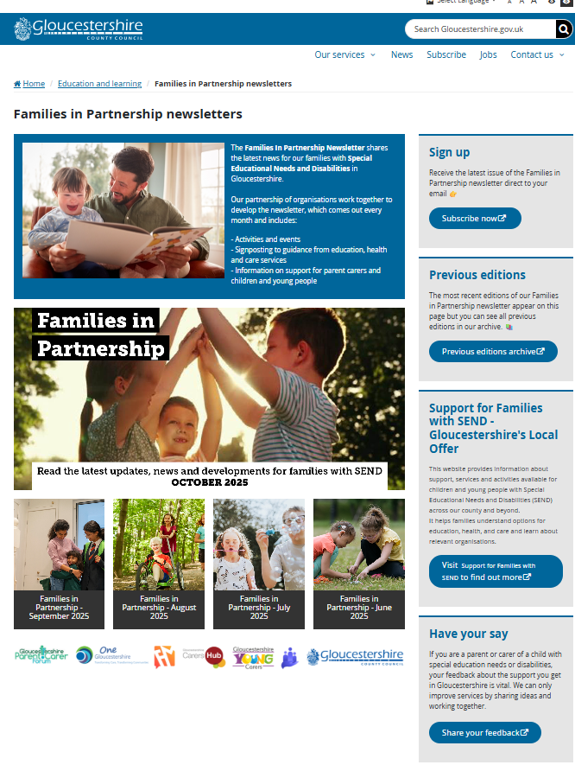
Annual Parent Carer Survey 2025
The SEND & Inclusion Local Area Partnership (SILAP) is required to survey parent carers about their experiences regarding services to support their children and young people’s needs.
What is the survey?
Last year the annual survey was completed by 422 parent carers, predominantly from White British communities and with school-aged children between 5-16 years. The data was analysed and will provide a baseline set of data for comparison. Feedback and views received have been responded to via the ‘You said, We Did’ Annual Report 2025, published earlier this month.
This year’s survey is now live?
In co-production with Gloucestershire Parent Carer Forum and SENDIASS, we have applied learning from last year, so this year’s survey is shorter and easier to complete – average completion time is now just 12 minutes.
The survey for 2025 went live on Monday, 6 October and will close on Friday, 5 December. It was published in October’s Families in Partnership newsletter, to which you, families and colleagues can subscribe.
Monday, 6 October
until
Friday, 5 December 2025

Slide 2

Annual Parent Carer Survey 2025
How you can help with this year’s survey?
Colleagues working with families:
Please share the survey widely with providers and professionals who can encourage and support families to complete it
Please help us reach many more families:
With children in Early Years and Post-16 so we get a full picture from across the 0-25 age range
From all communities across the county
Colleagues in schools and settings – resources available:
1. Posters and postcards - displaying a poster in your reception and distributing
postcards to all SEND families
2. Newsletters - including images and some ready-made text in any newsletters
3. Social media - including images and links to our video
4. Email signature block – add some ready-made text to your signatures
5. Presentations to parent carers – ready-made slides to share

